Slide 1

Parcel Delivery Trends: COVID-19 Impact Analysis
Exploring the seismic shifts in parcel delivery volumes and customer behavior during the COVID-19 pandemic
Data-driven insights into industry trends, customer segmentation, and future outlook
Presented by :-
Ashish Pandya
Dhruvil Patel

Slide 2

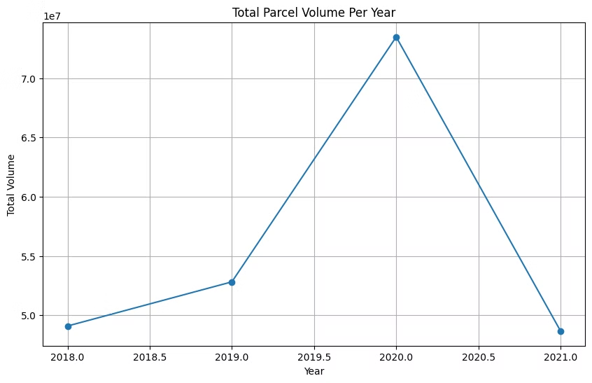
Total Parcel Volume Per Year
Significant growth in 2020
Peak parcel volume reached during pandemic year
E-commerce boom
Shift to online shopping drove volume increase
2021 decline
Volume decreased but remained above pre-2020 levels
Notes:
"COVID-driven e-commerce boosted 2020 volumes" This slide showcases the total parcel volume per year to highlight the growth in 2020, driven by the rise in e-commerce activity during the pandemic. The visual compares volumes from 2018 to 2021, with 2020 standing out significantly. Explain how lockdowns and changing consumer habits contributed to this increase. Emphasize the unprecedented growth rates during this period.

Slide 3

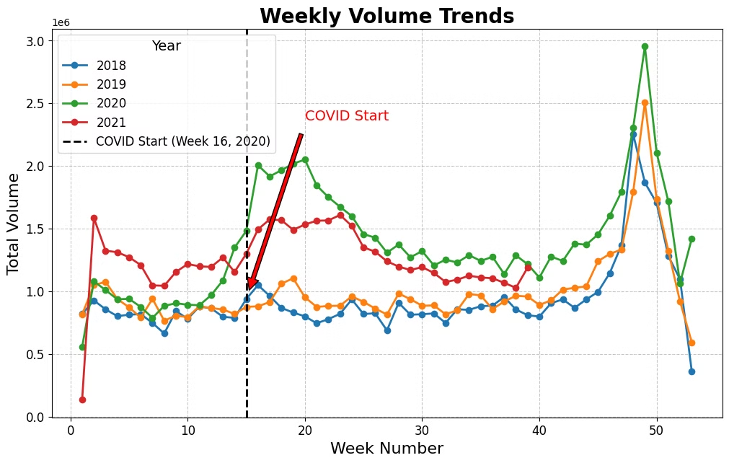
Weekly Volume Trends by Year
1
Pre-pandemic trends
Consistent patterns from 2018 to early 2020
2
Pandemic Start
Marked by vertical dashed line at Week 16, 2020
3
Volume surge
Significant increase post-pandemic onset
4
2021 decline
Volume decreased but remained above pre-pandemic levels
Notes:
"Trends pre-pandemic, onset, and decline" This slide displays weekly parcel volume trends for multiple years to analyze patterns over time. Highlight the steady pre-COVID volumes, followed by a sharp increase during the pandemic. Explain key points like volume spikes during peak seasons (holidays) and consistent growth trends during 2020. Mention how 2021 began stabilizing post-COVID but retained higher levels than pre-COVID.

Slide 4

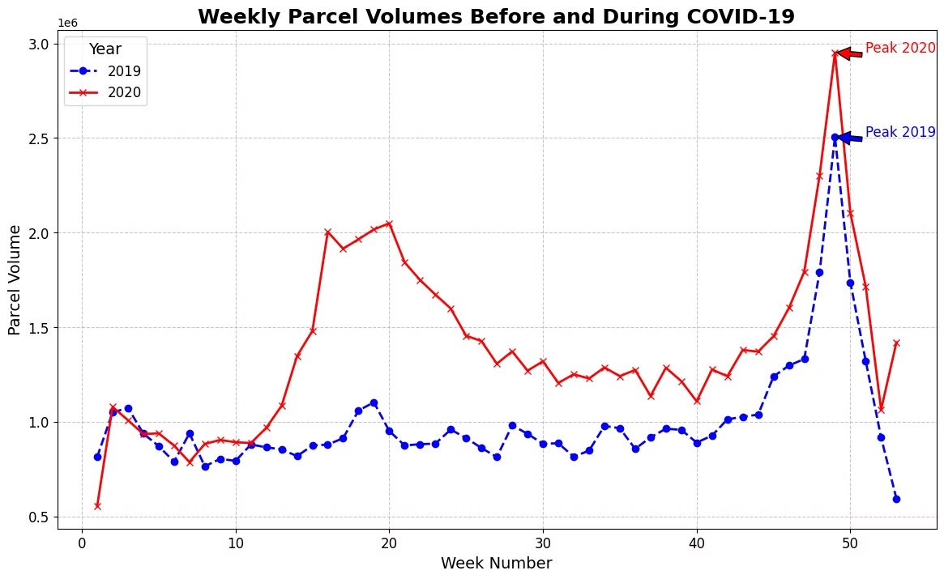




Weekly Parcel Volumes: Before and During COVID-19
2019 baseline
Typical seasonal patterns observed
2020 pandemic onset
Sharp increase around Week 16
Peak volume comparison
2020 peak significantly higher than 2019
Sustained growth
2020 volumes consistently above 2019 levels post-onset
Notes:
"2019 baseline vs 2020 peak volumes" This slide compares weekly parcel volumes between 2019 (pre-COVID) and 2020 (COVID-affected year). Discuss the sharp rise in volumes during Week 16 of 2020, coinciding with the onset of lockdowns and increased online shopping. Highlight how holiday seasons in 2020 surpassed 2019 significantly. Use this slide to showcase the pandemic's immediate impact.

Slide 5
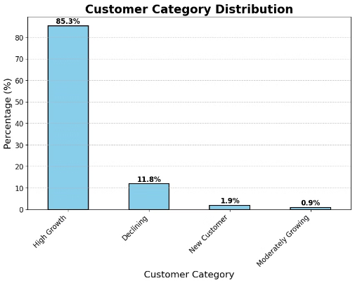
Customer Category Distribution
Moderately Growing
Declining
New Customers
0.9% of market
11.8% of market
1.9% of market
High Growth
85.3% of market
Notes:
"High Growth dominates customer categories" This slide categorizes customers into High Growth, Stable, Declining, and other groups based on their parcel volume growth rates. Explain that the High Growth category dominates, showing that many customers experienced substantial increases during COVID. Mention smaller portions in the Stable and Declining groups, highlighting the uneven impact of the pandemic.

Slide 6
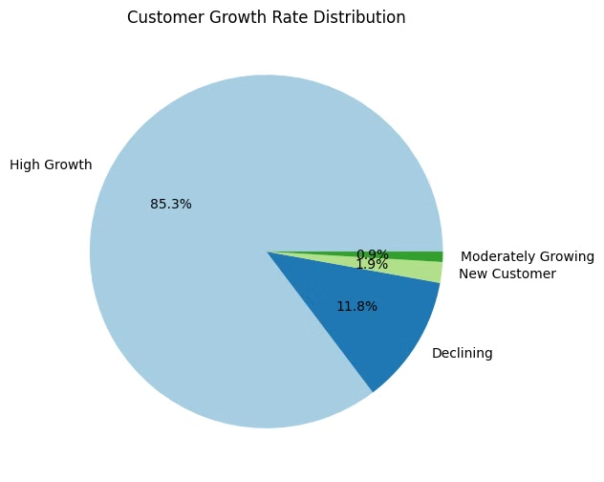
Customer Growth Rate Distribution
85.3%
11.8%
High Growth
Declining
Majority of customer base
Significant portion facing challenges
1.9%
0.9%
New Customers
Moderately Growing
Small but crucial segment
Smallest segment of customer base
Notes:
"High growth drives post-pandemic recovery" This slide focuses on growth rate percentages for each customer group. Highlight that High Growth customers significantly contributed to the overall volume increase during the pandemic. Mention that Declining and Lost customers are present but form a smaller portion. Explain how this growth distribution reflects the resilience and adaptation of businesses during COVID.

Slide 7
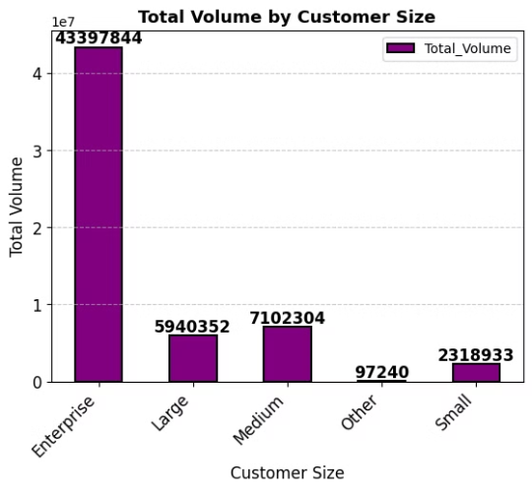
Total Volume by Customer Size
1
Enterprise
2
Large
3
Medium
43,397,844 units, highest volume
Significant but lower than Enterprise
Moderate contribution to total volume
4
Small & Other
Smallest contributors to overall volume
Notes:
"Enterprise dominates, others contribute moderately" This slide compares total parcel volumes by customer size (Enterprise, Large, Medium, Small). Discuss how Enterprise customers contributed the most to total volumes, followed by Large and Medium customers. Mention that Small customers, while fewer in volume, still represent important segments for future growth opportunities.

Slide 8
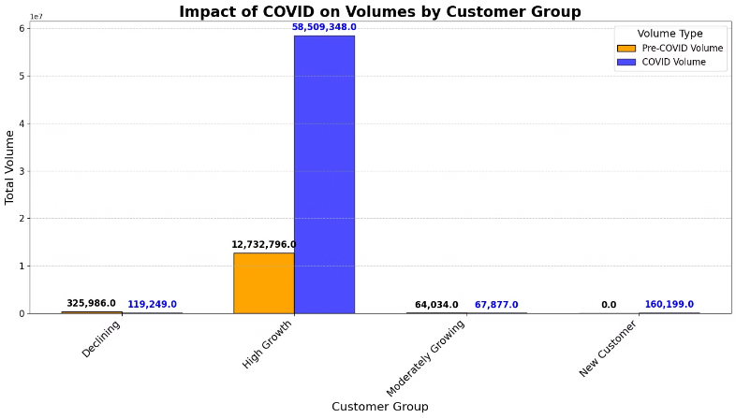
COVID-19 Impact on Volumes by Customer Group
High Growth
Other Groups
Pre-COVID: 12,732,796 units
Declining, Moderately Growing, New Customers
During COVID: 58,509,348 units
Varied growth or decline patterns
Dramatic increase in volume
Less significant changes compared to High Growth
Notes:
"High growth shows dramatic volume increase" This slide analyzes the overall volume and revenue impact by customer group. Highlight how High Growth customers showed the most dramatic increase in both metrics, while Stable customers maintained steady levels. Declining and Lost customers represent opportunities for targeted strategies to recover lost revenue.

Slide 9
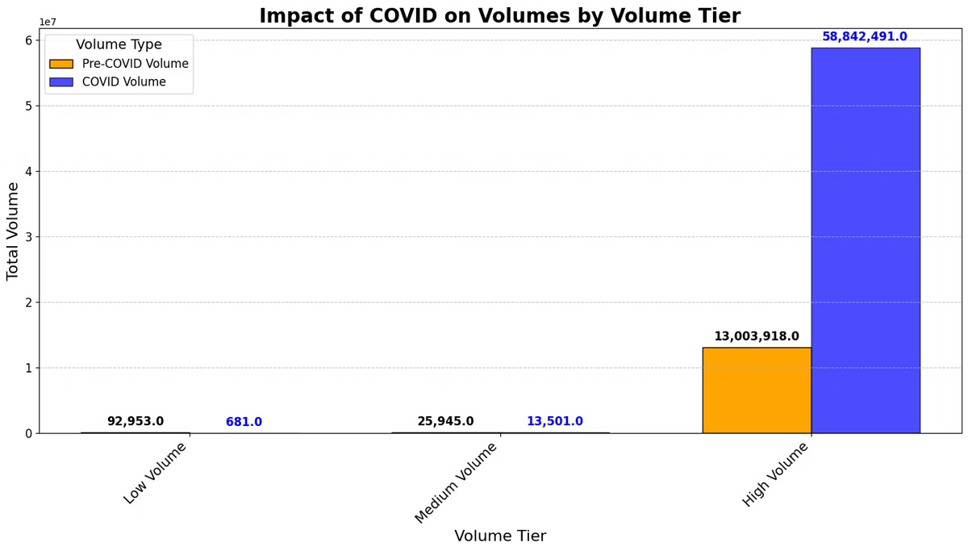



COVID-19 Impact on Volumes by Volume Tier
High Volume Tier
Pre-COVID: 13,501 units
During COVID: 50,642,491 units
All Tiers Growth
Significant volume increases across all tiers
Widespread Impact
COVID-19 affected all volume segments
Notes:
"High volume tier dominates impact" This slide focuses on the volume tier analysis, comparing Low, Medium, and High tiers. Discuss how High Volume customers contributed the majority of overall growth during COVID. Mention that Low and Medium tiers still play a role in total volumes but are significantly smaller than the High tier.

Slide 10
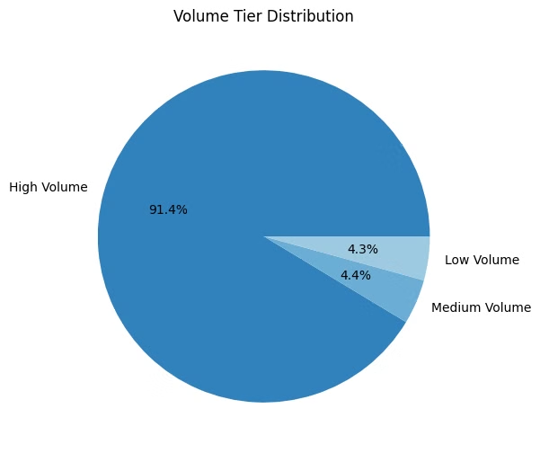
Volume Tier Distribution
1
High Volume
91.4% of total volume
Dominates the distribution
2
Medium Volume
4.4% of total volume
Significant but much smaller than High Volume
3
Low Volume
4.3% of total volume
Similar contribution to Medium Volume
Notes:
"91.4% of volume from high tier" This slide highlights the distribution of parcel volumes across tiers. Emphasize that over 91% of all parcel volumes during COVID came from the High Volume tier, reinforcing the dominance of top-tier customers. Conclude by stating that the High tier should remain a priority for business strategies.

Slide 11
Thank you

